Slide 1
Research Project Overview
Seshan Brothers

Slide 2
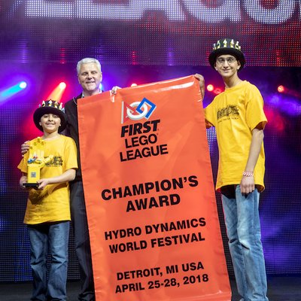
About The AUTHOR
Seshan Brothers were on team Not the Droids You Are Looking For
Our research project for Trash Trek was a Global Innovation Award semi-finalist project (Top 20 out of 30,0000 teams).
Our research project in Nature’s Fury won Innovative Solution at the FIRST LEGO League International Open in Toronto.
Our research project for World Class was EV3Lessons.com! ;-)
We are the Champion’s award winners from World Festival 2018

Slide 3

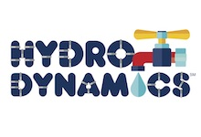
What is the Research Project?
A group research project related to the year’s theme
Come up with an innovative solution to a real-world problem
Themes:
2011: Food Factor (food safety)
2012: Senior Solutions (senior citizens)
2013: Nature’s Fury (natural disasters)
2014: World Class (education)
2015: Trash Trek (garbage)
2016: Animal Allies (animals)
2017: Hydro Dynamics (water)
2018: INTO ORBIT (space)

Slide 4
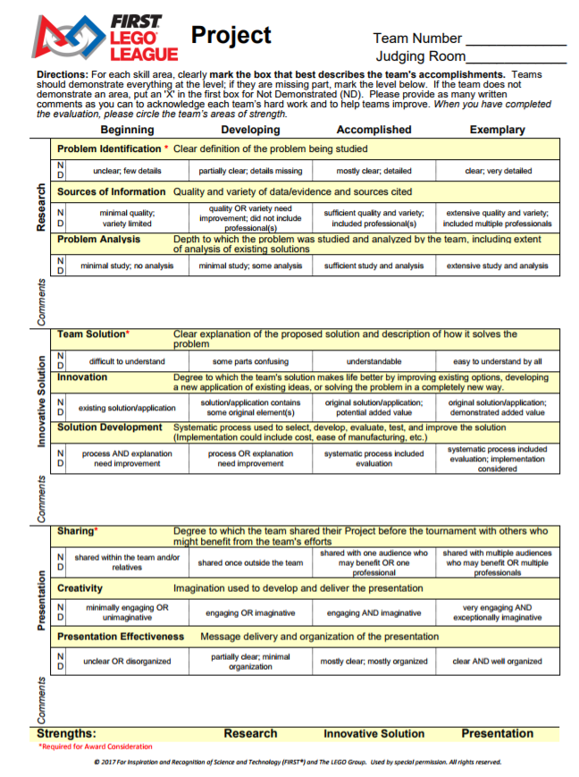
New Rubrics for 2017
Research
Identify a problem and analyze existing solutions
Innovative Solution
Develop a solution to your problem and understand what it would take to implement this idea.
Presentation
Share your project with people/organizations
Create an effective presentation for judges

Slide 5
Project Process
Identify a Problem
Background Research
Innovative Solution
Test Idea
Sharing/
Presentation
Research
Innovative Solution
Sharing
Look for lessons on each of these topics on FLLtutorials.com

Slide 6
SAMPLE PROJECTS
2011: Food Factor (food safety)
Detecting spoilt milk
2012: Senior Solutions (senior citizens)
Helping seniors remember where they left their possessions
2013: Nature’s Fury (natural disasters)
An early-warning ash detection system for airplanes
2014: World Class (education)
A better way to learn to program the EV3 (EV3Lessons.com)
2015: Trash Trek (garbage)
A more efficient way to recycle batteries
2016: Animal Allies (animals)
Bats getting killed by wind turbines
2017:Hydro Dynamics (water)
Detecting leaking pipes

Slide 7

Credits
This lesson was written by Sanjay and Arvind Seshan
More lessons available at www.ev3lessons.com and www.flltutorials.com

